Slide 1
Chapter 11: Trigonometric Identities and Equations
11.1 Trigonometric Identities
11.2 Addition and Subtraction Formulas
11.3 Double-Angle, Half-Angle, and Product-Sum Formulas
11.4 Inverse Trigonometric Functions
11.5 Trigonometric Equations

Slide 2
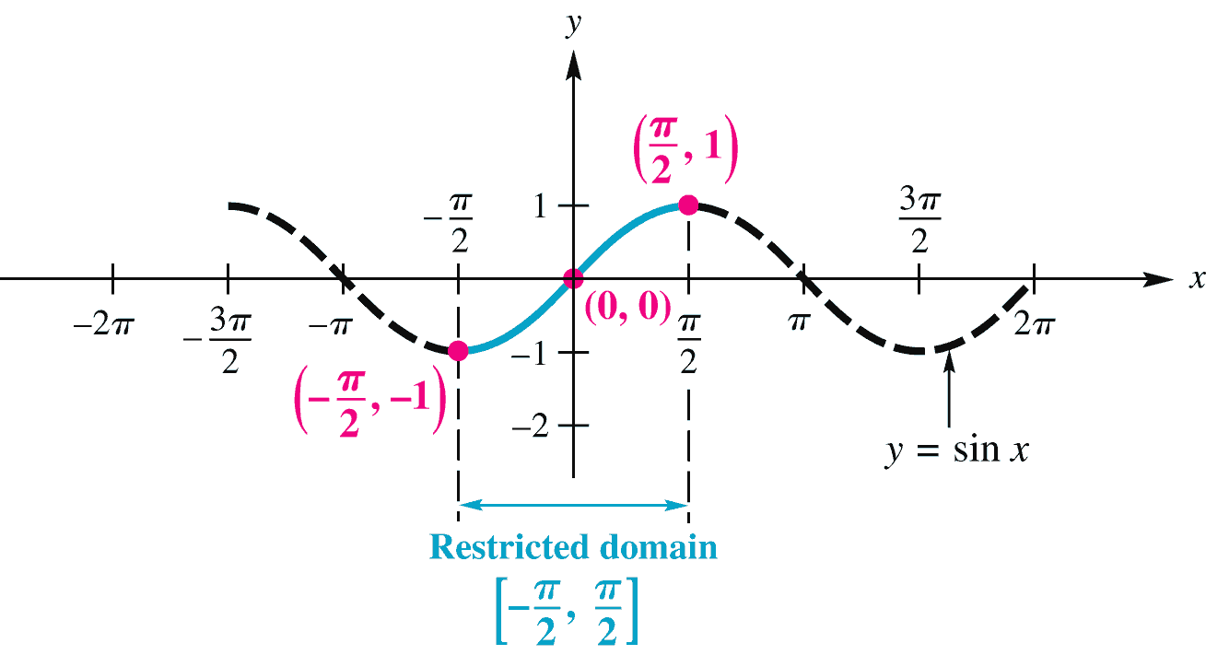
11.4 The Inverse Circular Functions
The Inverse Sine Function
Apply the horizontal line test to show that y = sin x is not one-to-one. However, by restricting the domain over the interval a one-to-one function can be defined.

Slide 3
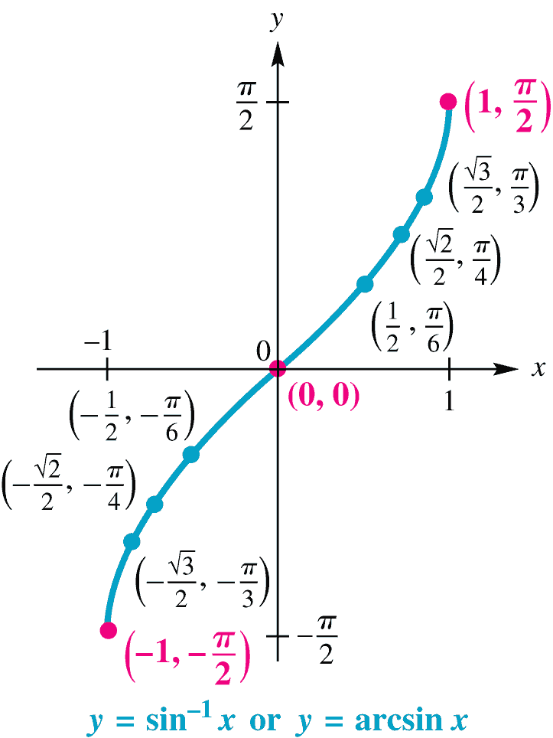
11.4 The Inverse Sine Function
The domain of the inverse sine function y = sin⁻¹ x is [–1, 1], while the restricted domain of y = sin x, [–π/2, π/2], is the range of y = sin⁻¹ x.
We may think of y = sin⁻¹ x
as “y is the number in the
interval whose sine
is x.
The Inverse Sine Function
y = sin⁻¹ x or y = arcsin x means that x = sin y, for

Slide 4
11.4 Finding Inverse Sine Values
Example Find y in each equation.
Analytic Solution
(a) y is the number in whose sine is Since
sin π/6 = ½, and π/6 is in the range of the arcsine function, y = π/6.
Writing the alternative equation, sin y = –1, shows that y = –π/2
Because –2 is not in the domain of the inverse sine function, y = sin⁻¹(–2) does not exist.

Slide 5
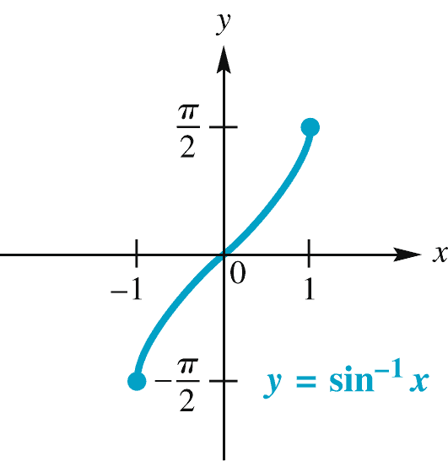
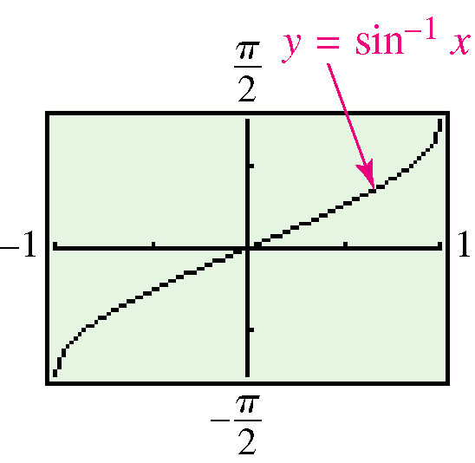
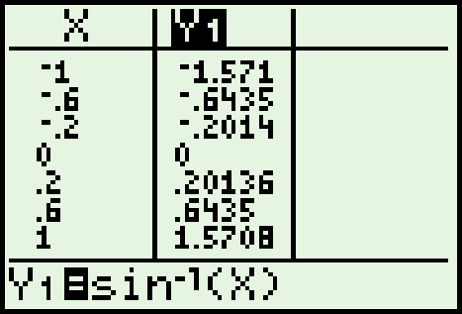
11.4 Inverse Sine Function
y = sin⁻¹ x or y = arcsin x Domain: [–1, 1] Range:
The inverse sine function is increasing and continuous on its domain [–1, 1].
Its x-intercept is 0, and its y-intercept is 0.
Its graph is symmetric with respect to the origin.

Slide 6
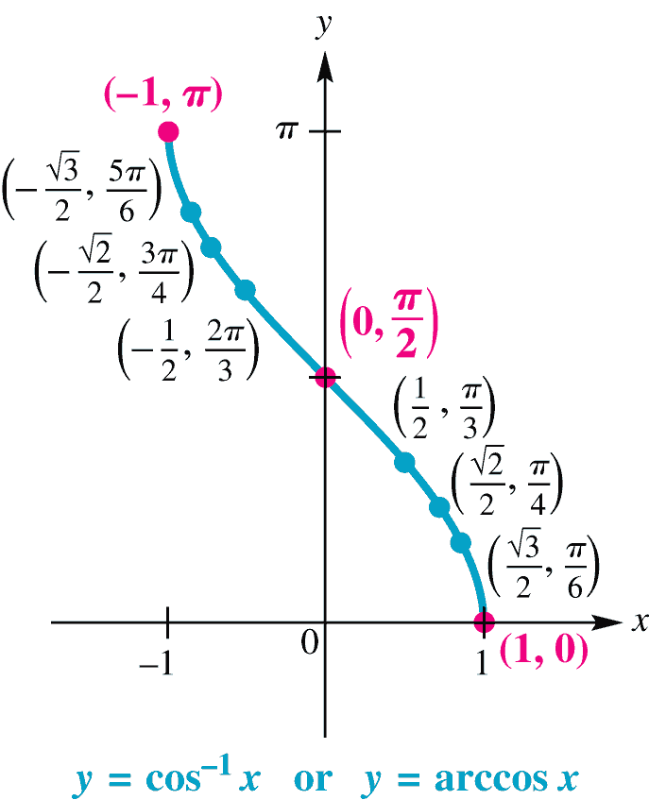
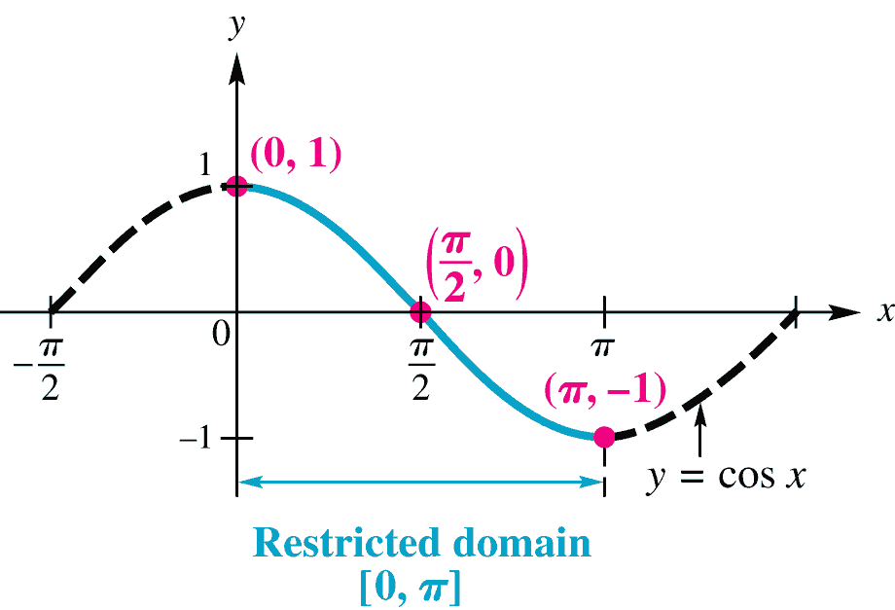
11.4 Inverse Cosine Function
The function y = cos⁻¹ x (or y = arccos x) is defined by restricting the domain of y = cos x to the interval
[0, π], and reversing the roles of x and y.
y = cos⁻¹ x or y = arccos x means that x = cos y, for
0 ≤ y ≤ π.

Slide 7
11.4 Finding Inverse Cosine Values
Example Find y in each equation.
Solution
Since the point (1, 0) lies on the graph of
y = arccos x, the value of y is 0. Alternatively,
y = arccos 1 means cos y = 1, or cos 0 = 1, so y = 0.
We must find the value of y that satisfies
cos y = 0≤ y ≤ π. The only value for y that satisfies these conditions is 3π/4.

Slide 8
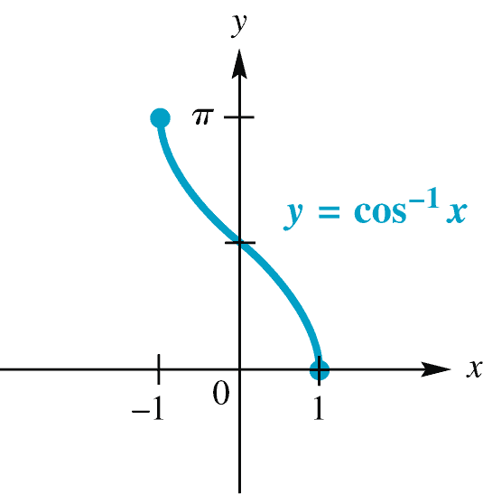
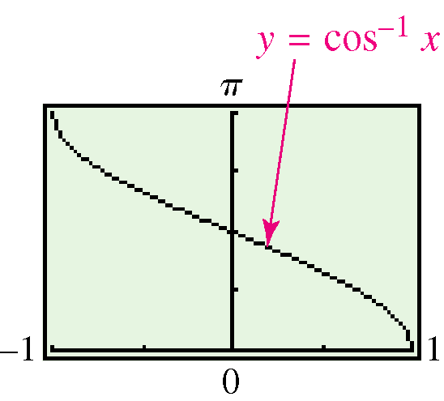
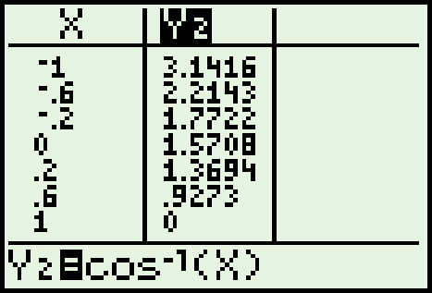
11.4 Inverse Cosine Function
y = cos⁻¹ x or y = arccos x Domain: [–1, 1] Range:
[0, π]
The inverse cosine function is decreasing and continuous on its domain [–1, 1].
Its x-intercept is 1, and its y-intercept is π/2.
Its graph is not symmetric with respect to the y-axis nor the origin.

Slide 9
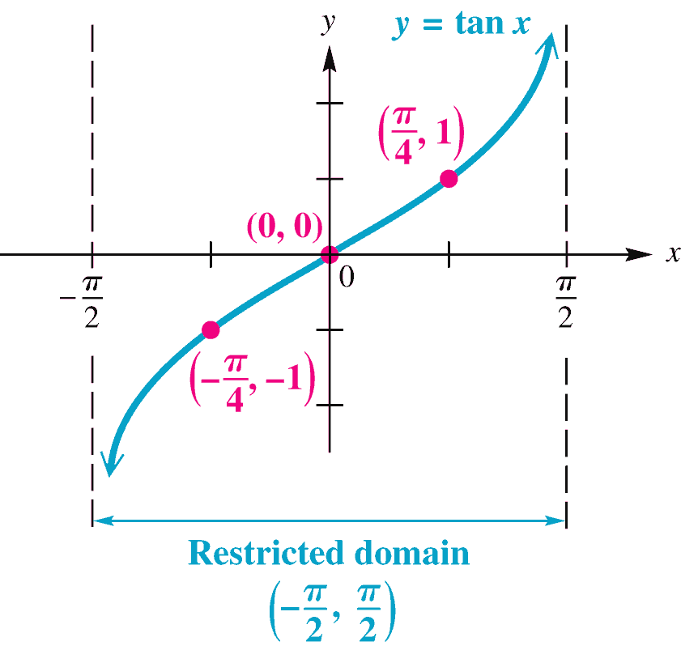
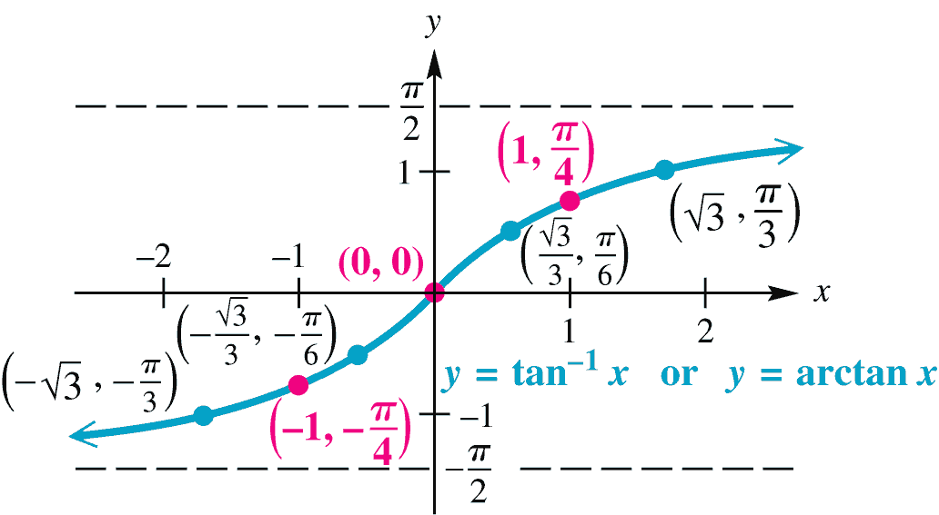
11.4 Inverse Tangent Function
The function y = tan⁻¹ x (or y = arctan x) is defined by restricting the domain of y = tan x to the interval
and reversing the roles of x and y.
y = tan⁻¹ x or y = arctan x means that x = tan y, for

Slide 10
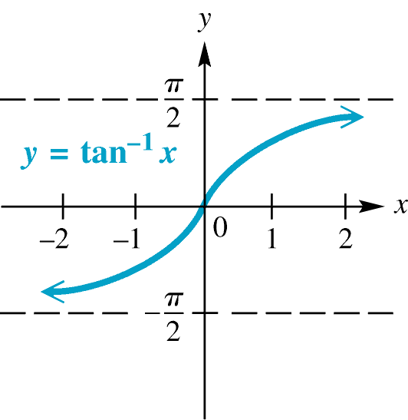
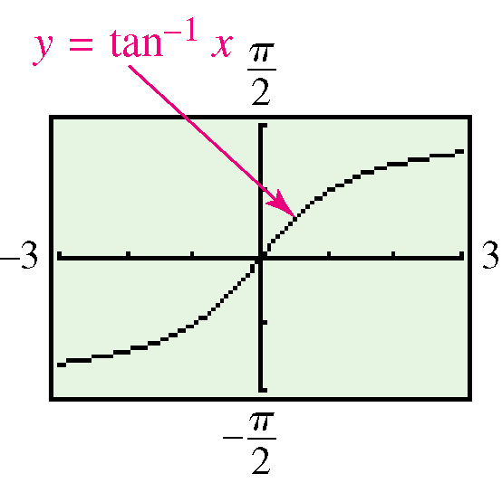
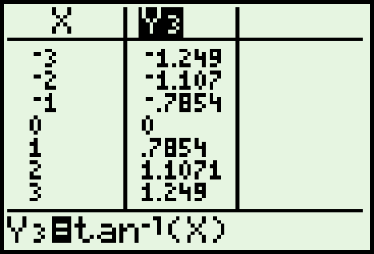
11.4 Inverse Tangent Function
y = tan⁻¹ x or y = arctan x Domain: (–∞, ∞) Range:
The inverse tangent function is increasing and continuous on its domain (–∞, ∞).
Its x-intercept is 0, and its y-intercept is 0.
Its graph is symmetric with respect to the origin and has
horizontal asymptotes y =

Slide 11
11.4 Remaining Inverse Trigonometric Functions
Inverse trigonometric functions are formally defined with real number values.
Sometimes we want the degree-measured angles equivalent to these real number values.
Function | Domain | Interval | Quadrants
y = sin⁻¹ x y = cos⁻¹ x y = tan⁻¹ x y = cot⁻¹ x y = sec⁻¹ x y = csc⁻¹ x | [–1, 1] [–1, 1] (–∞, ∞) (–∞, ∞) (–∞, –1] ∪ [1, ∞) (–∞, –1] ∪ [1, ∞) | [0, π] (0, π) [0, π], y ≠ | I and IV I and II I and IV I and II I and II I and IV

Slide 12
11.4 Finding Inverse Function Values
Example Find the degree measure of θ in each of the
following.
Solution
Since 1 > 0 and –90° < θ < 90°, θ must be in quadrant I. So tan θ = 1 leads to θ = 45°.
Write the equation as sec θ = 2. Because 2 is positive, θ must be in quadrant I and θ = 60° since sec 60° = 2.

Slide 13
11.4 Finding Inverse Functions with a Calculator
Inverse trigonometric function keys on the calculator give results for sin⁻¹, cos⁻¹, and tan⁻¹.
Finding cot⁻¹ x, sec⁻¹ x, and csc⁻¹ x with a calculator is not as straightforward.
e.g. If y = sec⁻¹ x, then sec y = x, must be written as follows:
From this statement,
Note: Since we take the inverse tangent of the reciprocal of x to find cot⁻¹ x, the calculator gives values of cot⁻¹ with the same range as tan⁻¹, (–π/2, π/2), which is incorrect. The proper range must be considered and the results adjusted accordingly.

Slide 14
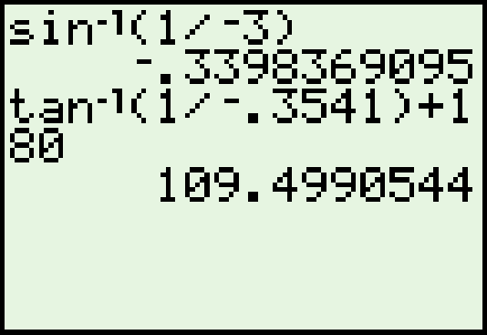
11.4 Finding Inverse Functions with a Calculator
Example
Find y in radians if y = csc⁻¹(–3).
Find θ in degrees if θ = arccot(–.3541).
Solution
In radian mode, enter y = csc⁻¹(–3)
as sin⁻¹( ) to get y ≈ –.3398369095.
In degree mode, the calculator gives
inverse tangent values of a negative
number as a quadrant IV angle. But
θ must be in quadrant II for a negative
number, so we enter arccot(–.3541) as
tan⁻¹(1/ –.3541) +180°, θ ≈ 109.4990544°.

Slide 15
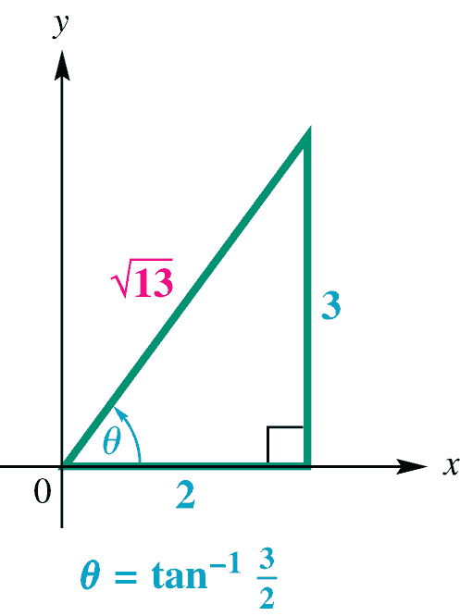
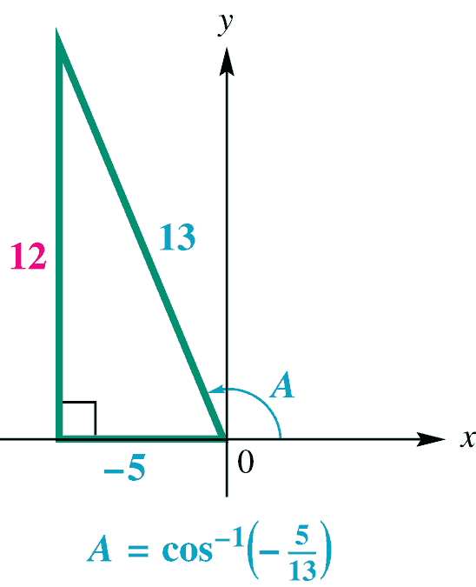
11.4 Finding Function Values
Example Evaluate each expression without a calculator.
Solution
Let θ = tan⁻¹ so that tan θ = . Since
is positive, θ is in quadrant I. We sketch
the figure to the right , so
Let A = cos⁻¹( ). Then cos A = .
Since cos⁻¹ x for a negative x is in
quadrant II, sketch A in quadrant II.

Slide 16
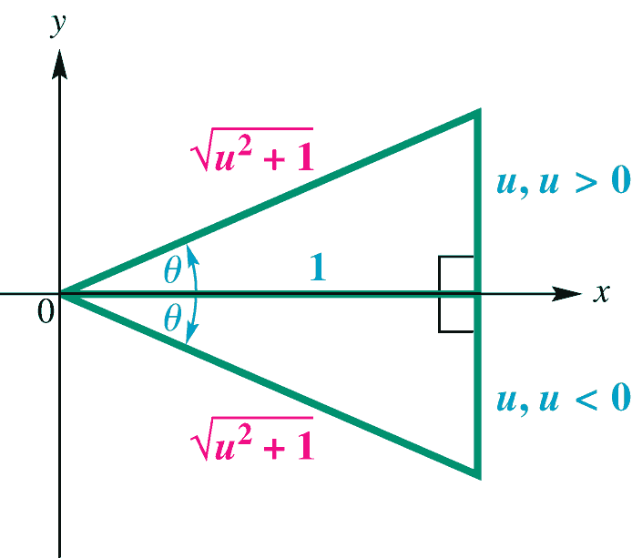
11.4 Writing Function Values in Terms of u
Example Write each expression as an algebraic expression in u.
Solution
Let θ = tan⁻¹ u, so tan θ = u. Sketch θ in quadrants I and IV since
Let θ = sin⁻¹ u, so sin θ = u.

Slide 17
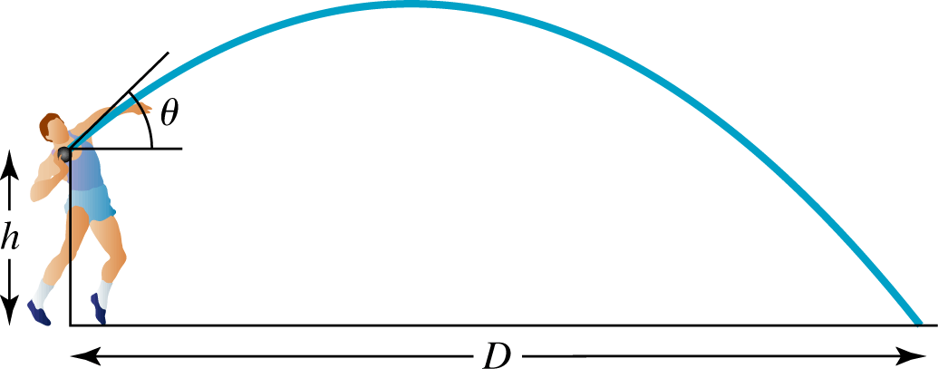
11.4 Finding the Optimal Angle of Elevation of a Shot Put
Example The optimal angle of elevation θ a shot putter should aim for to throw the greatest distance depends on the velocity of the throw and the initial height of the shot. One model for θ that achieves this goal is:
Figure 32 pg 9-73

Slide 18
11.4 Finding the Optimal Angle of Elevation of a Shot Put
Suppose a shot putter can consistently throw a steel ball with
h = 7.6 feet and v = 42 ft/sec. At what angle should he throw the
ball to maximize distance?
Solution
Substitute into the model and use a calculator in degree mode.

